Slide 1
We help people change the way they think and act on energy

Slide 2
The Centre for Sustainable Energy
Vision- sustainability, reduced carbon emissions, fair access to affordable energy
Mission- share knowledge and practical experience, empower others
With 100 staff we have up to 100 different, separately-funded projects at any one time
“Change the way people think and act around energy”
Notes:
Established since 1979 we are a charity supporting people and organisations across the UK to tackle the climate emergency and end the suffering caused by cold homes
Our vision is a world where sustainability is second nature, carbon emissions have been cut to safe levels and fuel poverty has been replaced by energy justice.
Our mission is to share our knowledge and practical experience to empower people to change the way they think and act about energy.
At any one time we have about 100 staff working on around 100 different and separately-funded projects. All of these are helping people and communities to meet real needs for both environmentally sound and affordable energy services.

Slide 3
Safe and Warm Somerset
Offers advice and support to all residents on anything energy related.
We focus on the energy efficiency of the clients home, energy efficient behaviour and supplier or billing issues.
Clients can call the advice line or be referred to an Energy Advisor to support them with their issue.
safeandwarmsomerset@cse.org.uk
Refer your client or patient | Centre for Sustainable Energy (cse.org.uk)
Notes:
We offer an Advice Line open Monday to Friday from 9.00am to 5.00pm 0800 0822234
You can refer clients via the online referral form https://www.cse.org.uk/refer-a-patient-or-client/
Our Case workers provide 1-1 support
There are lots of resources, leaflets, social media posts, newsletters and videos
Our Outreach worker – visits events, provides advice surgeries and information stands as well as informal talks to community groups

Slide 4
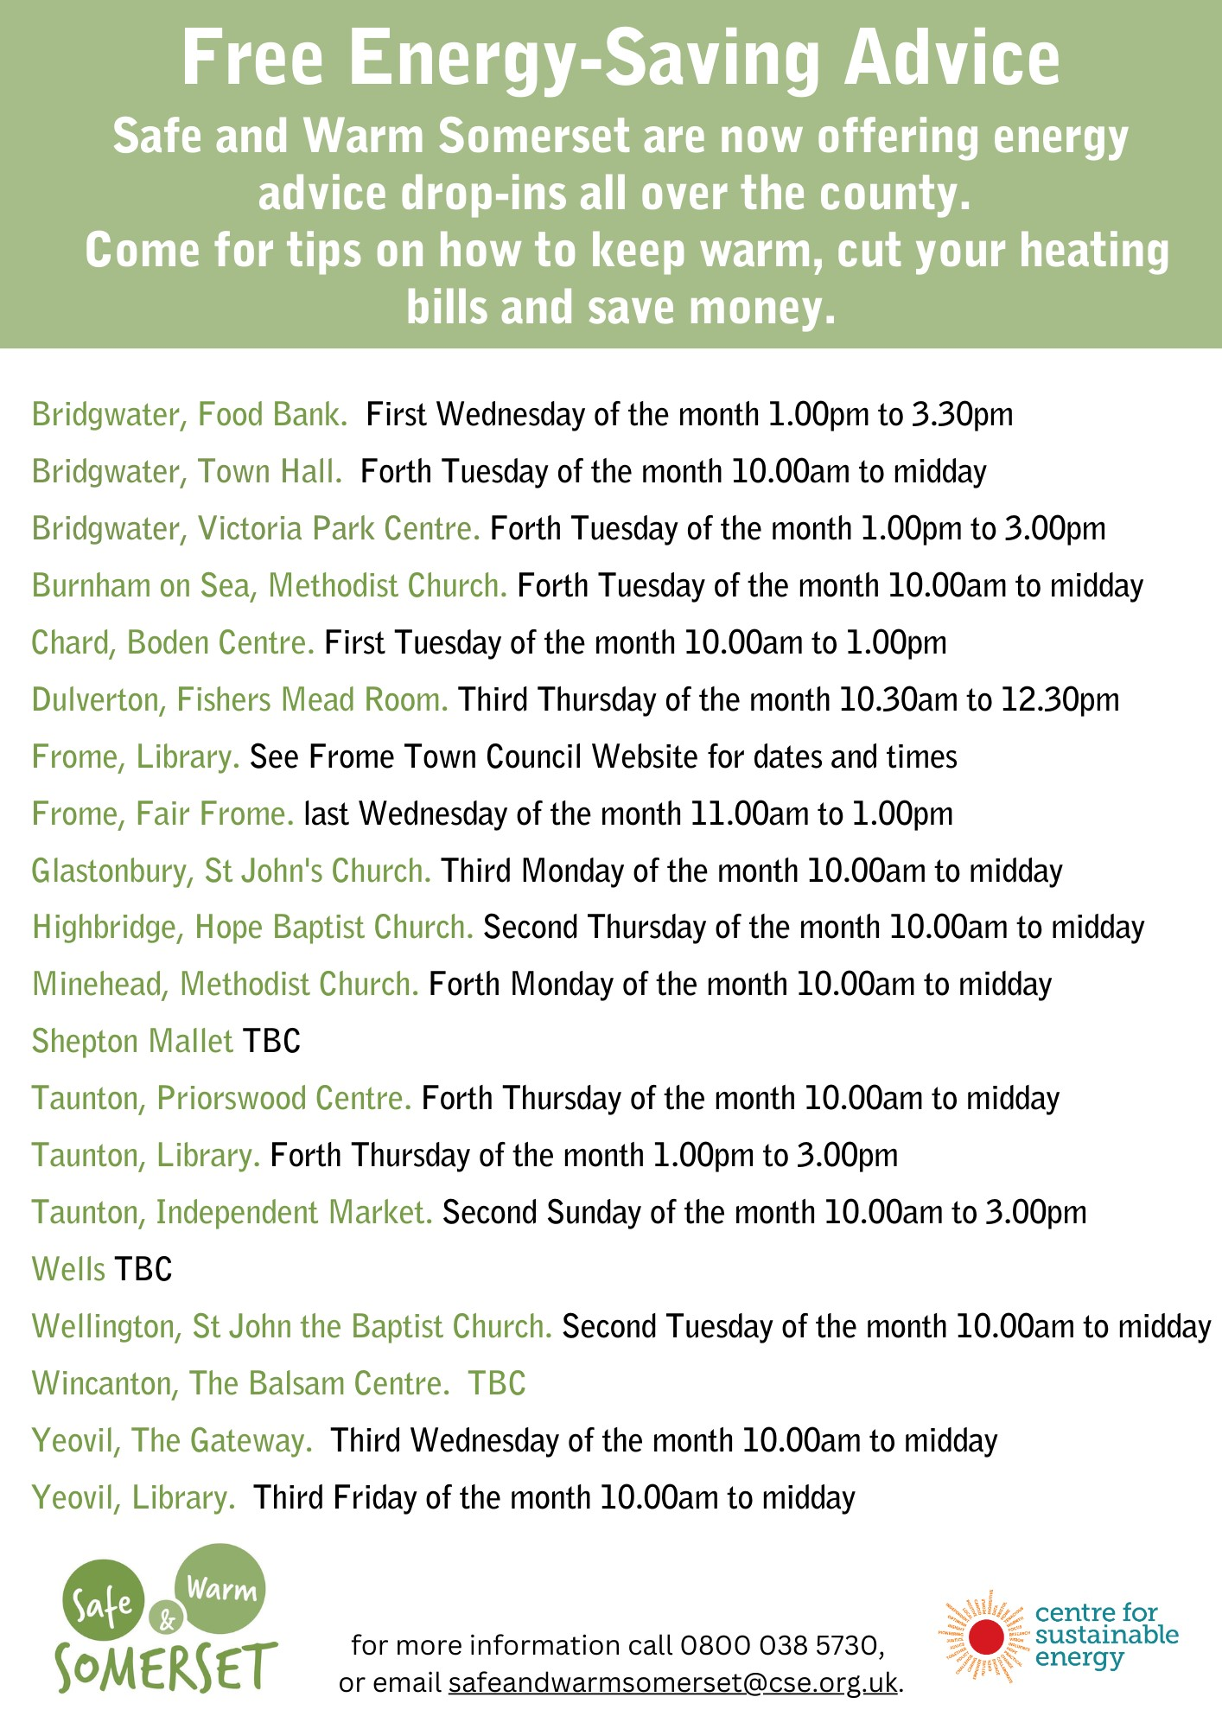
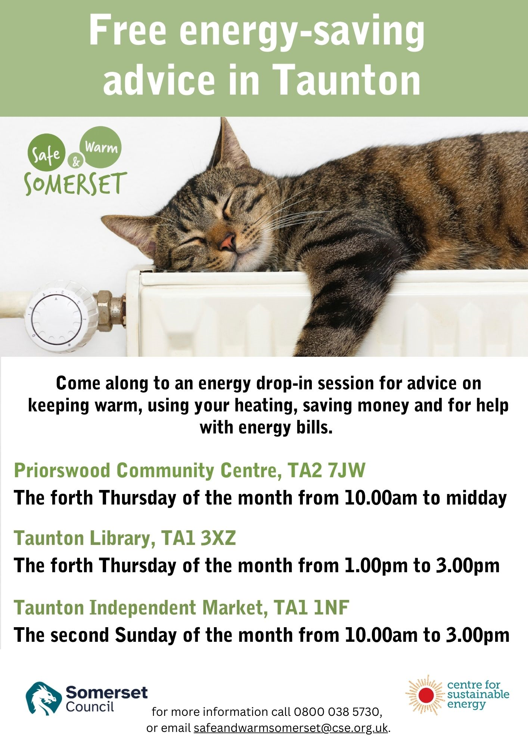
Notes:
Across county drop ins
19 different sessions in 14 different towns

Slide 5
Fuel Poverty
Low Income Low Energy Efficiency
They are living in a property that has an EPC below D and their disposable income (income after housing costs and energy needs) would be below the poverty line
Or around 10% of income spent on fuel costs
Estimated 3.2 million households in England are defined as fuel poor (2019) – this is 13.4% of households
In Somerset that’s 24,135 households in fuel poverty and around 24% of homes rated band E or below EPC
Notes:
So why do we do what we do?....
Fuel poverty is determined by a combination of three factors: • energy efficiency of the home • household income • fuel costs
They are living in a property that has an energy efficiency rating band D, E, F or G and their disposable income (income after housing costs and energy needs) would be below the poverty line.
It used to be measured as over 10% of income being spent on fuel costs so around 10% is a good guide
According to 2020 government statistics you are more likely to be fuel poor if
you are living in privately rented properties
You are unemployed
Have a PPM
Single parent household
If your property has a low EPC more than doubling costs from A to G
Somerset Fuel Poverty – 9.7%
Number of households in Somerset in fuel poverty – 24,135
24% rated band E or below EPC
•9% households in Wiltshire and Swindon in fuel poverty
•14% of Wiltshire properties EPC Band E or below

Slide 6
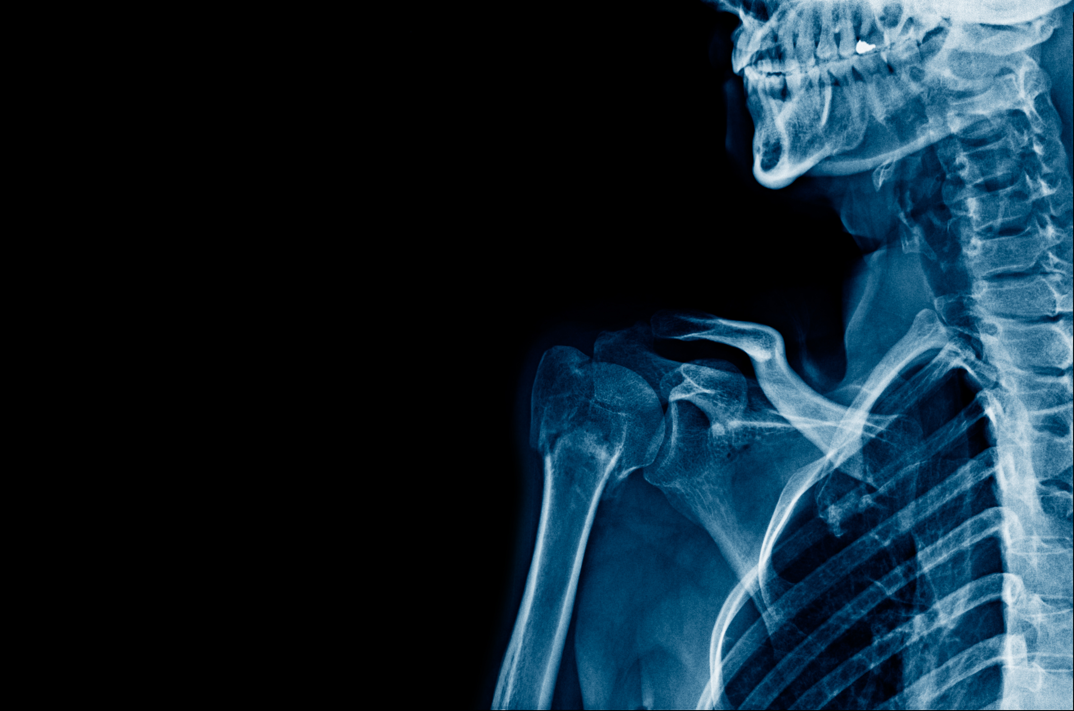
Physical Health impacts
Direct effects of winter weather include an increase in incidence of:
Heart attack
Stroke
Respiratory disease
Influenza
Falls and injuries
Notes:
So why do we do what we do?....
The impact of cold weather on health Direct effects of winter weather include an increase in incidence of: • heart attack • stroke • respiratory disease • influenza • falls and injuries • hypothermia Indirect effects of cold include mental health illnesses such as depression.
Cardiovascular disease
Indoor temperatures of 12°C or less can cause a constriction in the blood vessels, resulting in a rise in blood pressure. Thickening of the blood further increases the risk of clots. If these clots form in the heart and brain vessels, they can lead to heart attack and stroke.
Respiratory illnesses
Exposure to cold indoor or outdoor temperatures suppresses the immune system; diminishes the lungs’ capacity to fight off infection; and increases constriction of the airways. These factors are associated with an increased risk of bronchitis and pneumonia.
Falls and injuries
Cold homes affect mobility and increase the likelihood of falls and injuries – especially in frail and elderly people – symptoms of arthritis worsen in cold, strength and dexterity decrease as temperatures drop.
After the coldest day, the second day there is a peak in heart attacks, deaths from strokes peak on day 5, and respiratory deaths at day 12. it take 40 days to return to normal.

Slide 7
Mental Health impacts
Direct effects of winter weather include an increase in incidence of
Stress and anxiety
Depression
Guilt
Social isolation
Notes:
So why do we do what we do?....
Indirect effects of cold include mental health illnesses such as depression.
Mental and social health and wellbeing
Damp, cold housing is associated with an increase in mental health problems, such as depression and anxiety.
Living in these homes can affect people’s ability to go about their daily lives.
The worry of how to afford the bills
Day in and day out being cold is exhausting and miserable
Embarrassed, ashamed and guilty – not being able to support the household and deliver the basic requirements for a decent standard of living
Knock on effects of lack of sleep, and lack of concentration
Some become socially isolated as they are reluctant to invite friends or family to a cold house.

Slide 8
Excess Winter
Mortality Rates
The UK experiences, on average, between 27,000 and 32,000 excess winter deaths
Excess winter deaths in the coldest quarter of housing are almost three times as high as in the warmest quarter.
A third of excess winter deaths are attributed to the AVOIDABLE circumstances of living in a cold home
Notes:
So why do we do what we do?....
The UK experiences, on average, between 27,000 and 32,000 excess winter deaths.
Deaths are 3 times more likely to occur in the coldest homes - 71% of Excess Winter Deaths happen to people living in the coldest 25% of houses
About a third of these deaths are attributable to the avoidable circumstances of living in a cold home – about the same as the number of people who die from breast or prostate cancer each year.
Somerset 310 deaths in 2019/20 = roughly 100 avoidable deaths.
Wiltshire 320 excess winter deaths in 2019/20 = roughly 100 avoidable deaths.

Slide 9
Listen - We need to actively listen to the things that people say
Notice - What do we notice when we visit the home?
Ask - Be Nosey! or professionally curious and ask questions to find out more
Notes:
How do we as advisors and agents in the community identify people that are at risk of being one of those excess winter deaths, or noticing those who are fuel poor?
Listen
We need to actively listen to the things that people say things like
oh I don’t understand that thing on the wall”
“they keep sending me letters but I don’t read them”
I wish I could have stayed in hospital, its so much nicer there”
What you notice when you visit:
Do you want to take your coat off?
Does it smell of damp?
Are they only using one room?
Is the house in disrepair?
ASK - Be nosey / professionally curious – ask questions to understand what's going on for the client. Don’t leave the situation unchallenged
ACT – hopefully the things we are going to talk about today will give you some more tools to offer energy advice and help households improve their circumstances.
So when a client has been identified, what can we do about it?
We need to know more about their Energy behaviour, Energy Bills and the Home

Slide 10
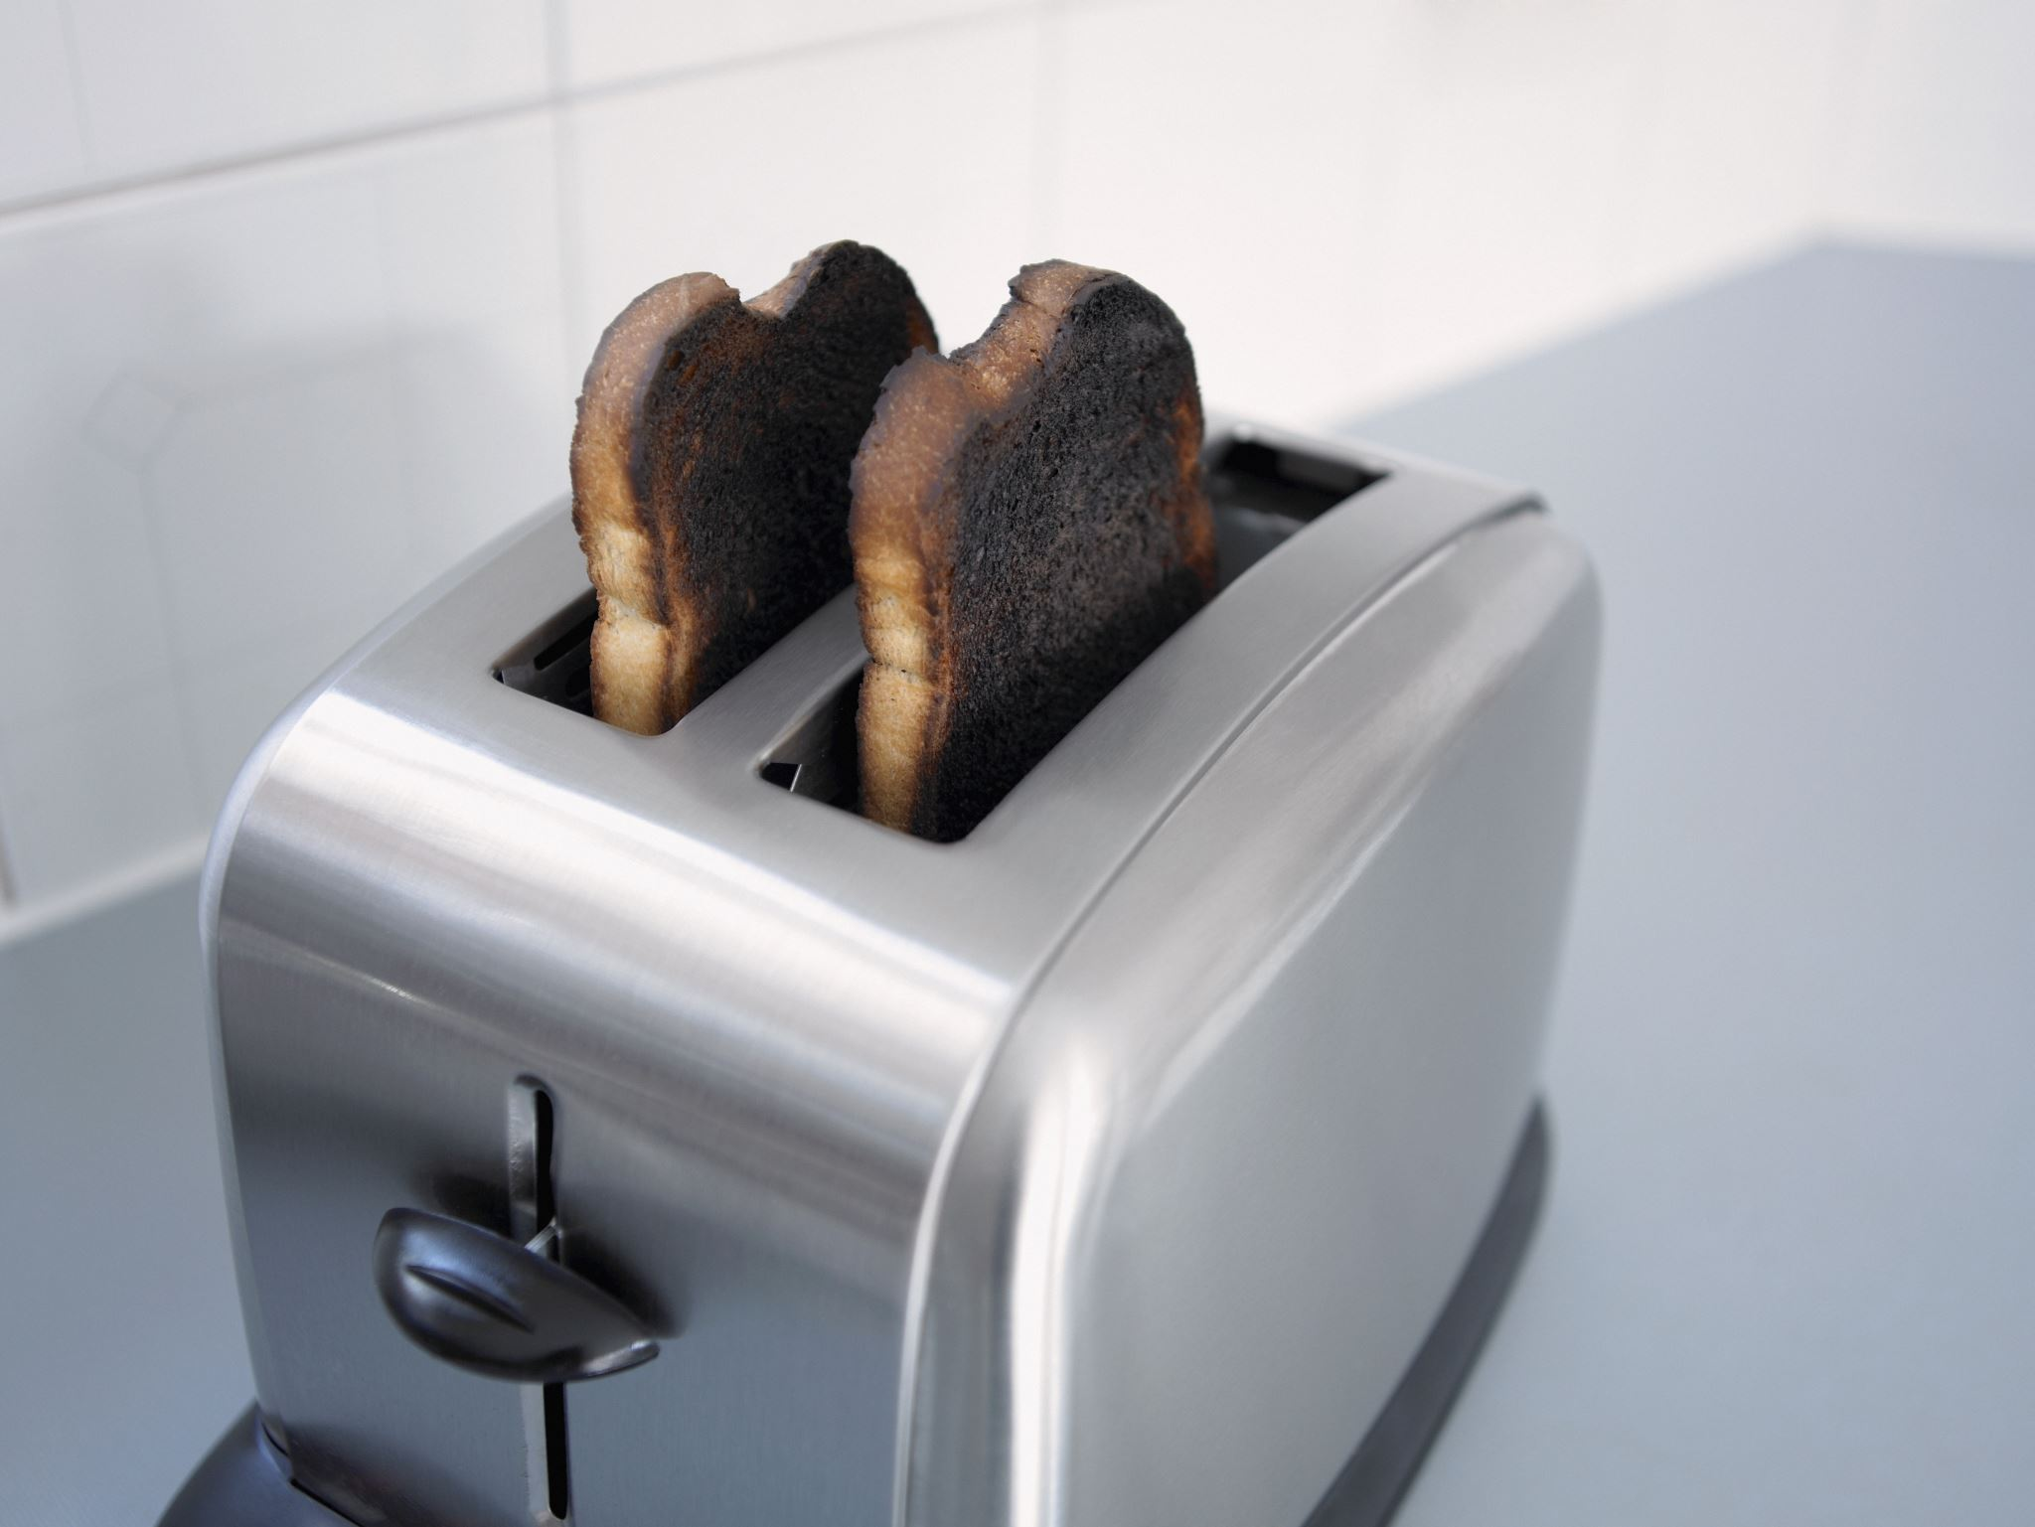
Energy efficient behavioural advice
Heating the home
Heating water
Lighting and Appliances
Energy saving tips
Energy saving in an energy crisis
Notes:
So How do we make the situation better?
We always focus on heating and hot water first as this is the most expensive thing we do.
We aim to match the controls to the way clients live their lives, making sure they are warm enough but that they are not wasting energy and money.
Adjust the heating controls so it matches the lifestyle and only have it on when it needs to be on
Set thermostat between 18-21˚C, each 1˚C costs roughly 10% so turning it down by 1 degree, may not even be noticed but it will save money.
We have lots of other energy saving tips that we can share with you to advise your clients (but only after the heating)
During the crisis we have had to adapt the advice we give, in some cases reassuring clients and encouraging them to turn their heating on as many people are anxious about the cost. We have tips on what you can advise your clients to do if they are in a desperate financial situation.

Slide 11
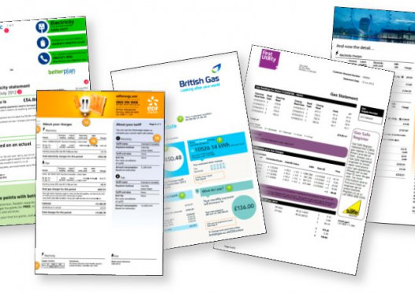
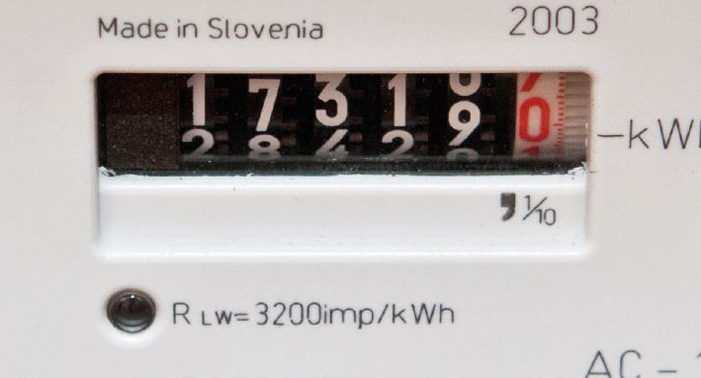
Energy Supplier and Distributor Advice
Priority Services Register
Energy Bills
Financial support
Debt
Meters
Payment methods
TARIFFS
Notes:
We encourage you to join any vulnerable client you are working with to the PSR with the distributor and suppliers
Many client struggle to understand their bills, there is a lot of information on them if you know what your looking for,
There is lots of financial support available from the government and charities.
If clients have a lot of debt or lots of little debts, it would be better for them to get debt advice from an agency but we deal with many client that have debts and have lots of tips to share with you.
Meter readings are really important. The more information the suppliers have the more accurate their bills and Direct debits will be

Slide 12
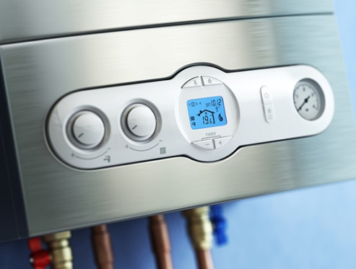
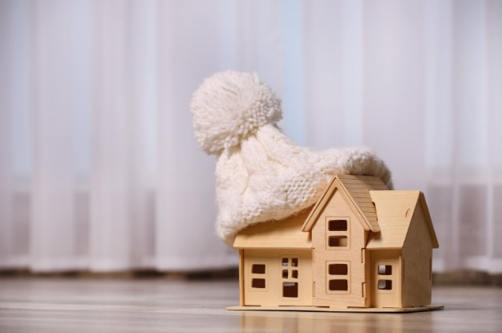
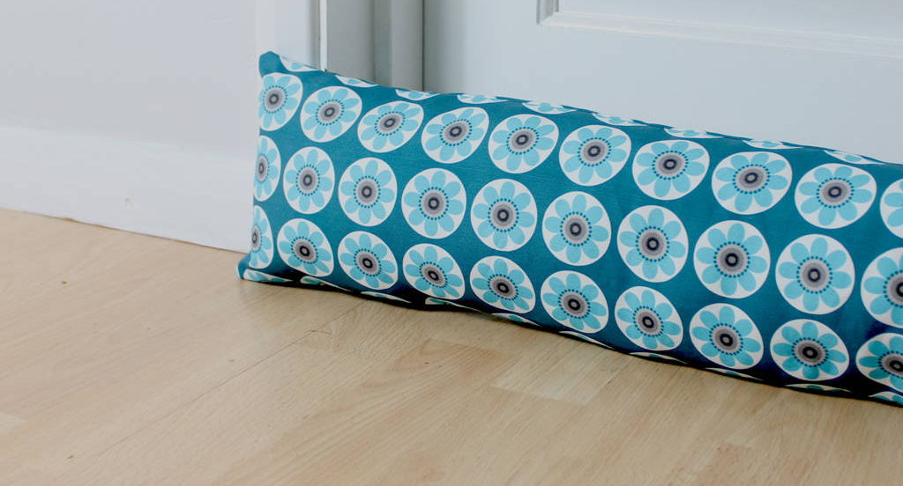
Energy Efficient Property Advice
Insulation
Draught proofing
Heating options
Cold, damp and Condensation
Grants and Funding
Notes:
we invest a lot of time and money into our homes our rent/mortgage is the probably our biggest bill. We spend money on wallpaper and paint to make it look nice, we also want it to feel nice. Our homes should be safe and warm.
We cant stop the heat leaving the home but we can slow it down by insulating and draught proofing.
The type of heating a client has, how old it is, and whether it is serviced will all have an impact of the EE of the home.
We have lots of advice and a whole separate training session on damp and mould.
There are lots of grants available but they change all the time so call us to check or refer your client to us.

Slide 13
Rural Community Energy Support Network
RCESN is available to staff, volunteers and community organisations to help them have better energy related conversations with their customers
Network members will have access to a series of short knowledge sessions to cover the basics of energy advice.
On going support is offered in the form of 1-1 Mentoring, support sessions, resources such as fact sheets and step-by-step guides, online forum for peer-to-peer knowledge-sharing
Sign Up (google.com)
Notes:
So how can we help you to help your clients
I can talk to ten potential clients, but if I can train 10 people each of those can talk to ten people and that 100 energy related conversations. And hop[efully we can identify and help more people that need support
We now have over 200 network members in Somerset – some have come to the training, made changes to their home and talked to their neighbour, where as others have built it into their daily work and talk to everyone they meet about their energy consumption or issues.
We provide…..

Slide 14
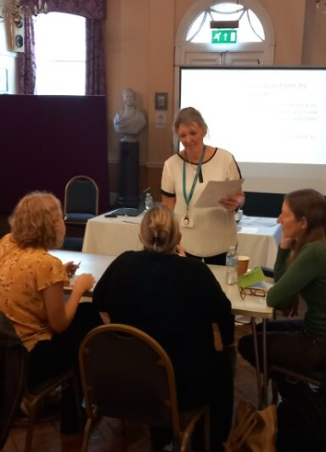
Training
Basic energy advice
Damp, mould and condensation
Managing bills and dealing with suppliers
Heating options and controls
Home improvements and Draughtproofing
How to run a community workshop
Notes:
Training sessions on line or in person – whole staff teams or individuals
Quarterly Forums
Weekly drop in sessions
Teams call or email me
And a Teams channel to post questions to the whole team

Slide 15
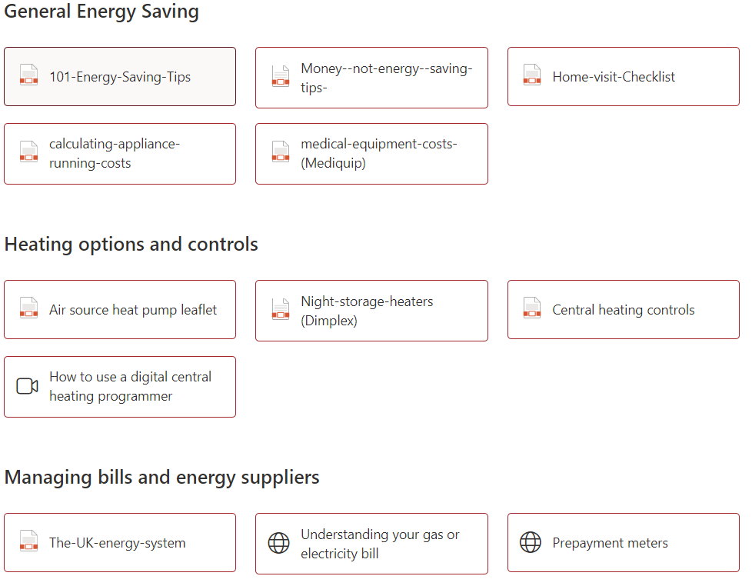
Notes:
Resources on our Sharepoint

Slide 16
Feedback to us
Stay in touch with us and let us know how many people you have helped with energy advice
Notes:
All we ask as ‘Payment’ for all the training and support is that you let us know how many energy related conversations you are having.
We currently have a ‘report outcomes’ button on the sharepoint site for you to do this.
We don’t want the reporting to get in the way of you giving advice but we do need to report back to our funders to evidence that this project is making an impact.

Slide 17
Have Energy Related Conversations
Support your clients and/or community, run events and share resources

Slide 18
Thank You
safeandwarmsomerset@cse.org.uk
WWW.CSE.ORG.UK
0800 0822234
deb.g@cse.org.uk

