Slide 1
Care Homes in Somerset
Gemma Beasley
Senior Commissioning Officer – Residential, Dementia Residential and Nursing.
James Sangster
Service Manager – Commissioning – Older person services

Slide 2
Agenda
01. Introduction
02. Overview from
2021-2023
A breakdown of Somerset Council’s presence in the care home market.
Changes in Somerset’s Care Home Market since 2021.
03. What’s next
04. Decision making.
05. Any questions?
Taking a look at data, population predictions and current/future gaps in the market.
The main factors impacting decision making regarding choosing a care home.
Or suggestions of what you would like to see from commissioning.

Slide 3

Introduction
Currently Somerset Council fund on average 1316 residential and nursing placements for the people of Somerset. This number hasn’t fluctuated noticeably over the last two years.
This equates to funding 42% of the occupied nursing capacity and 36% of the occupied residential capacity within Somerset.
On average the sourcing care team are searching on behalf of 80 people a month, looking for permanent care home. This is around 15-20 new requests a week. 33% of total requests being nursing home requests and 26% being residential home requests.
75% of the people looking for permanent placement are coming from a hospital or pathway bed. Compared to 25% of people who are looking to move from home into a care home.

Slide 4

Since 2021
Since 2021 16 Care Homes have closed in Somerset.
Totalling:
361 residential beds
144 nursing beds
Mainly in South Somerset, and Sedgemoor.

Slide 5
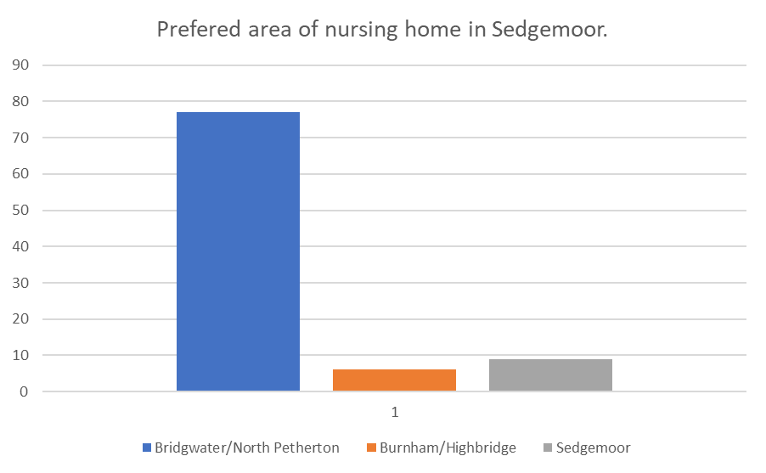
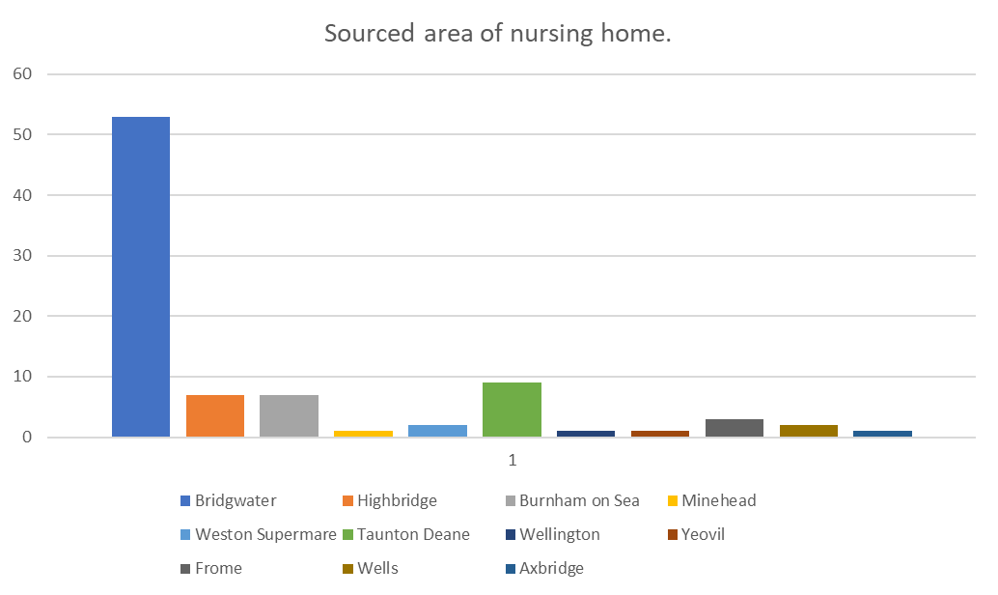
Demographic data – Sedgemoor nursing homes

Slide 6
Sedgemoor: nursing homes.
Total home’s:
Total bed’s:
7 nursing homes.
198
Average occupancy levels:
Combined vacancies Admittable:
90% occupied.
17 admittable vacancies.

Slide 7
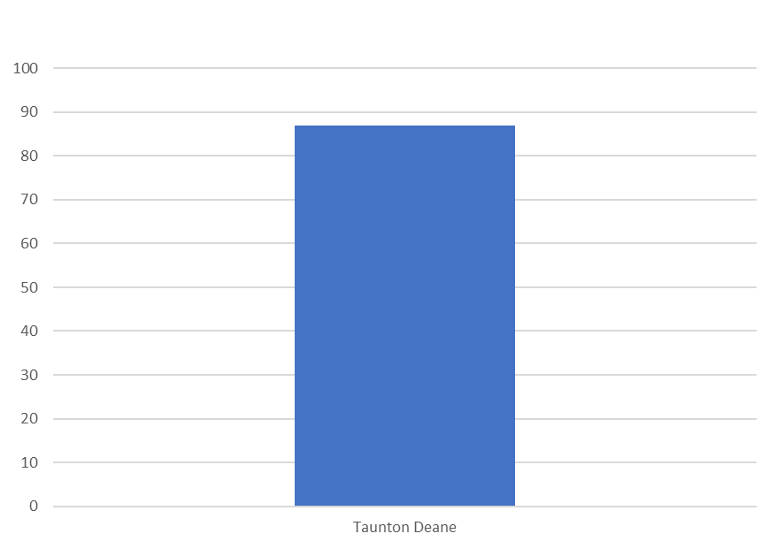
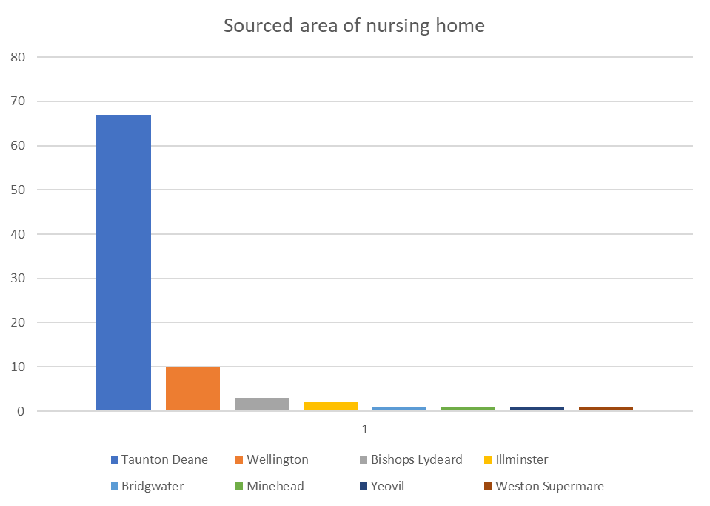
Demographic data – Taunton nursing homes

Slide 8
Taunton: nursing homes.
Total home’s:
Total bed’s:
16 nursing homes.
407
Average occupancy levels:
Combined vacancies admittable:
84.1%
75 admittable nursing vacancies.

Slide 9
The aging population predictions of Somerset.
Somerset has a much larger aging population than other parts of the UK. It is visible the reduction of people in their 20’s and 30’s, which is typically attributed to outward migration for education and or/employment opportunities. Retirees tend to migrate towards Somerset therefore adding to the aging population.

Slide 10
Predicted population increases 2016 - 2041
Sedgemoor
Taunton Deane
Mendip
+16%
+14%
+12%
South Somerset
West Somerset
+8%
+5%

Slide 11
Decision making
Suitability
No matter whether it be an individual looking for a care home for themselves or loved one, care home employee, trusted assessor, or local authority employee these three items need to align for an offer to be accepted.
Cost
Area

Slide 12
Aims for 2024/2025
Commissioning perspective:
Care provider perspective:
Other professionals' perspective:
Would like to support with future planning.
Start to see improved ‘crisis’ situations of vacancies levels.
Set up forum’s or adapt LEMs to create regular opportunities.
X
Y
Z
X
Y
Z

Slide 13

Any questions?
Thank you for your time.
We look forward to continuing to work together.
Direct line: 01823 357579
Email address: Gemma.Beasley@somerset.gov.uk

